Slide 1
Boot Camp Data Analytics Project: AFL Statistics Project members: Karin Ferradda, Josh Thomas, Andy de Wind
Analysis of AFL Statistics
Brownlow Home and Away Votes
Free Kicks Home and Away
Win Loss record Home and Away

Slide 2
The aim of this presentation is to see if we can answer the following questions:
Do more Brownlow votes go to players on home teams or away teams?
Do home teams get more free kicks than their visiting opponents?
How do teams perform in front of their home fans. Better or worse?

Slide 3
1. Brownlow votes
The data for this study came from the website:
https://afltables.com/afl/afl_index.html
Umpires vote on the Best on Ground (BOG) for each home and away game according to the following:
The central field umpires gather together after the game to vote accordingly:
Best player gets 3 votes,
Second best gets 2 votes and
Third best gets 1 vote
This is done only during home and away matches culminating on the Monday before the Grand Final on Brownlow night when the votes are tabulated and the winner is announced as Fairest and Best play for the whole home and away season. Votes for players who miss 1 or more games due to foul play are considered ineligible

Slide 4
The data analysis was done across 3 seasons 2017, 2018 and 2019. Seasons 2020 and 2021 were not included as they were seasons that were affected by CoViD hubs. This is where teams several teams were based in one city and played each other on the same ground for a few rounds due to the Corona virus pandemic and subsequent quarantine rules.

Slide 5

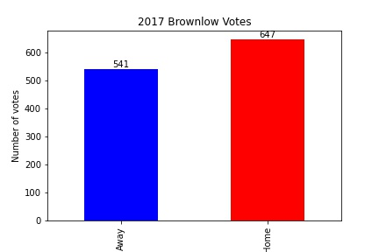
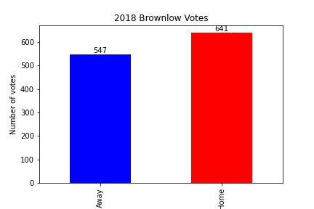
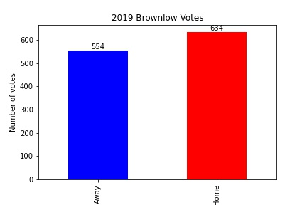
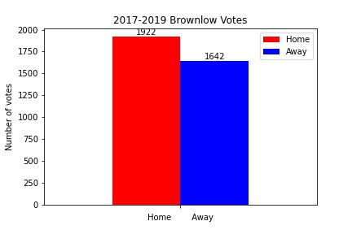

Slide 6
Conclusion: It would appear that players on home teams do get more votes than players on visiting teams. This could be related to teams playing at home do better in front of their home supporters and hence get the umpires’ votes.

Slide 7
2. Win Loss record for Home and Away fixtures. This analysis is for all home and away seasons going back over 30 years and attempts to answer the question: How do teams perform in front of their home fans. Better or worse? Some of the clubs no longer exist like Fitzroy whilst others are fairly new and hence have played less games. Teams like Greater Western Sydney (GWS) and Gold Coast (GC).

Slide 8
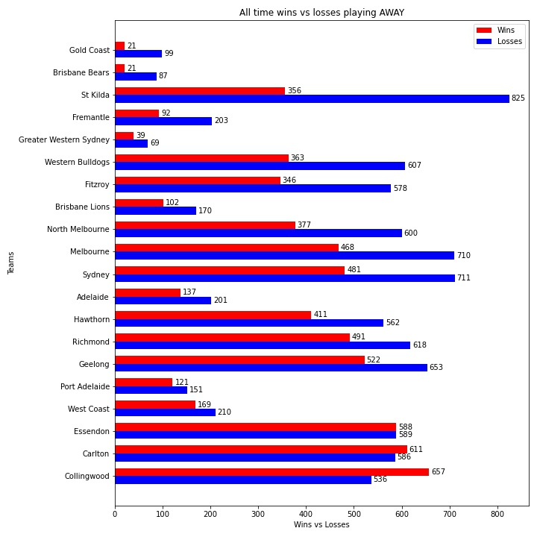
All time wins vs losses by teams when playing AWAY
There is clearly a trend that teams playing AWAY lose more games than when they play at HOME in front of more of their fans.
There are some exceptions for example Brisbane Bears, they were a new team established in NRL territory so they had few fans attending their home games but when they became the Brisbane Lions after merging with the established Melbourne club Fitzroy they gained a lot more fans and their win/loss record went the other way.
However some of the established Melbourne based clubs like Collingwood and Carlton went against trend as a lot of their away games were played at their home ground like the MCG which they share with other Melbourne clubs. A good attendance by supporters at games does seem to impact the outcome.

Slide 9
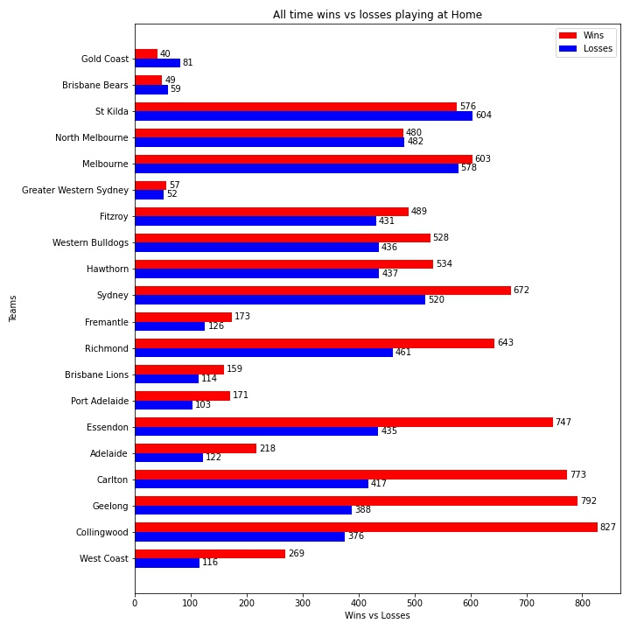
All time wins vs losses by teams when playing at HOME
There is clearly a trend that teams playing at HOME win of their games than when they play away in front of less of their fans.
There are some exceptions for example Brisbane Bears, they were a new team established in NRL territory so they had few fans attending their home games but when they became the Brisbane Lions after merging with the established Melbourne club Fitzroy they gained a lot more fans and their win/loss record went the other way.
However some of the established Melbourne based clubs like Collingwood and Carlton went against trend as a lot of their away games were played at their home ground like the MCG which they share with other Melbourne clubs. A good attendance by supporters at games does seem to impact the outcome.

Slide 10
3. Freekicks awarded during the Home and Away fixtures. This analysis is for all home and away seasons going back over 30 years and attempts to answer the question: Do home teams get more free kicks than their visiting opponents?

Slide 11
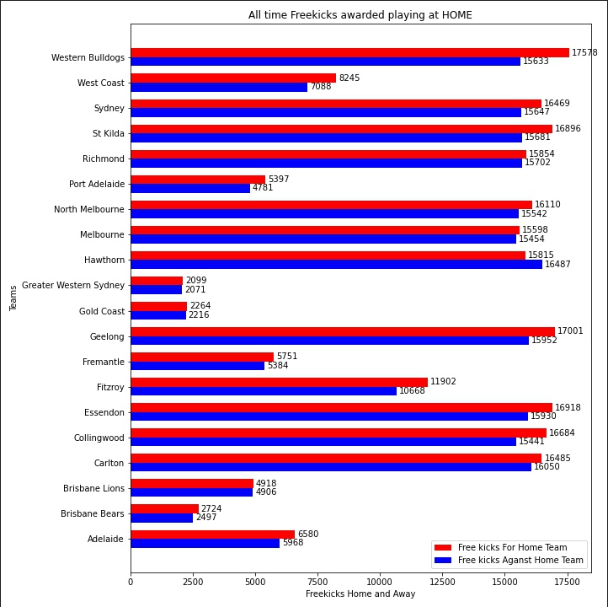
The conclusion that may be drawn from this graph is that teams playing at home do tend to get more freekicks in their favour whereas playing away gets them less. There are some exceptions but that appears to be with Melbourne based clubs who do play a lot of their away games at their home ground but with less of their fans able to attend. So fan support appears to have some bearing on the outcome.

Slide 12
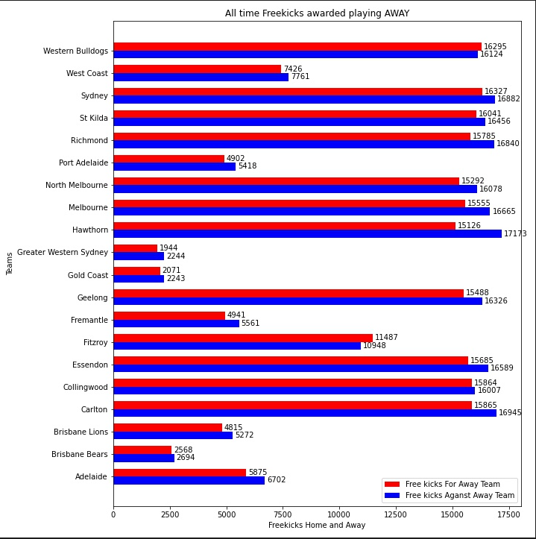
The conclusion that may be drawn from this graph is that teams playing away do not tend to get more freekicks in their favour whereas home teams do. There are some exceptions but that appears to be with Melbourne based clubs who do play a lot of their away games at their home ground but with less of their fans able to attend. So fan support appears to have some bearing on the outcome.

